Slide 1
SSc Methylation Data Analysis
2015.8.13

Slide 2
Methylation 450K Array
Analysis Pipeline
CD4 vs.CD8 Analysis
CD4 Total Analysis
CD4 subtype Analysis
CD8 Total Analysis
CD8 subtype Analysis
CD4&CD8 Total Analysis
SLE CD4 MDS plot
Data Quality

Slide 3
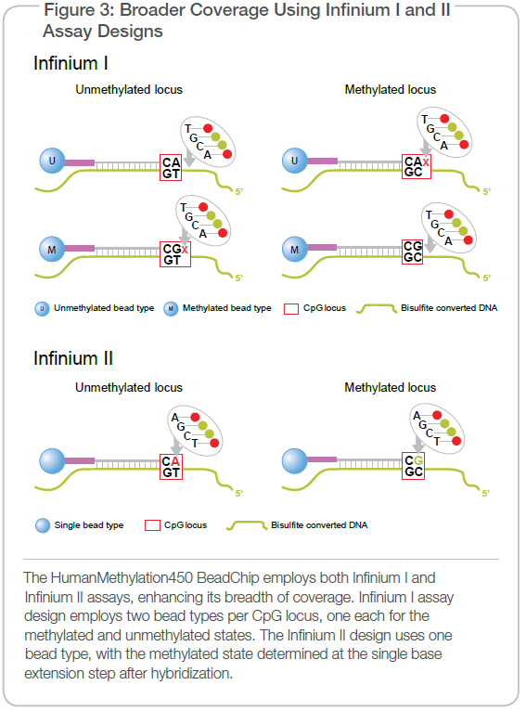
Illumina Methylation 450K Array Design

Slide 4
Methylation 450K Array
Analysis Pipeline
CD4 vs.CD8 Analysis
CD4 Total Analysis
CD4 subtype Analysis
CD8 Total Analysis
CD8 subtype Analysis
CD4&CD8 Total Analysis
SLE CD4 MDS plot
Data Quality

Slide 5
Available R packages
Methylumi
Lumi
IMA
Minfi
wateRmelon
ChAMP: CNV calling
RnBeads: HTML & sequencing based DNAm data

Slide 6
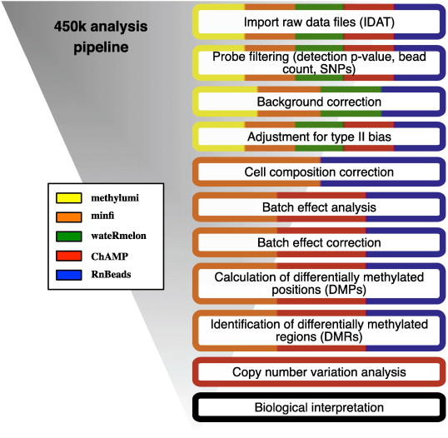
Illumina Methylation 450K Array Analysis Pipeline

Slide 7
Methylation 450K Array
Analysis Pipeline
CD4 vs.CD8 Analysis
CD4 Total Analysis
CD4 subtype Analysis
CD8 Total Analysis
CD8 subtype Analysis
CD4&CD8 Total Analysis
SLE CD4 MDS plot
Data Quality

Slide 8
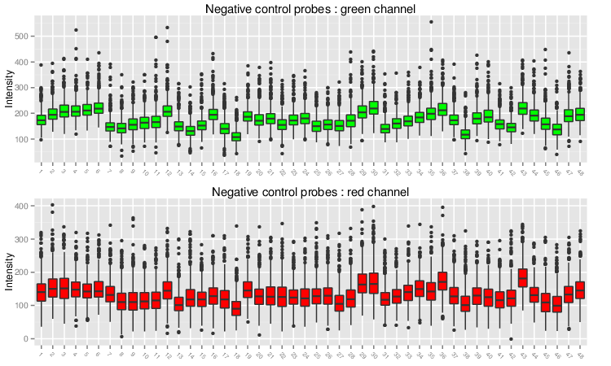
Data Quality-1
Negative Control Box Plots

Slide 9
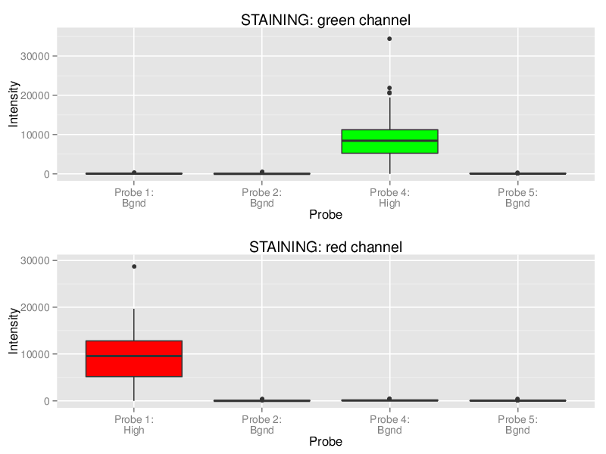
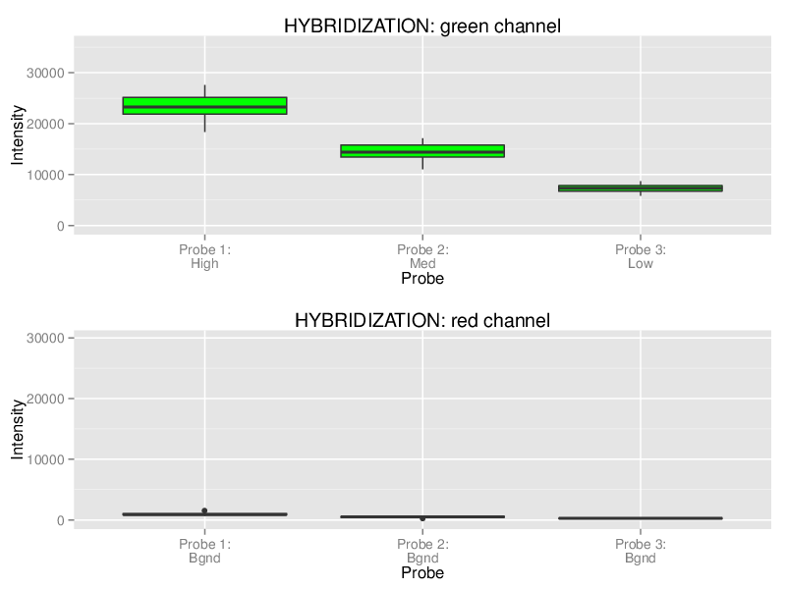
Data Quality-2
Quality Control Box Plots

Slide 10
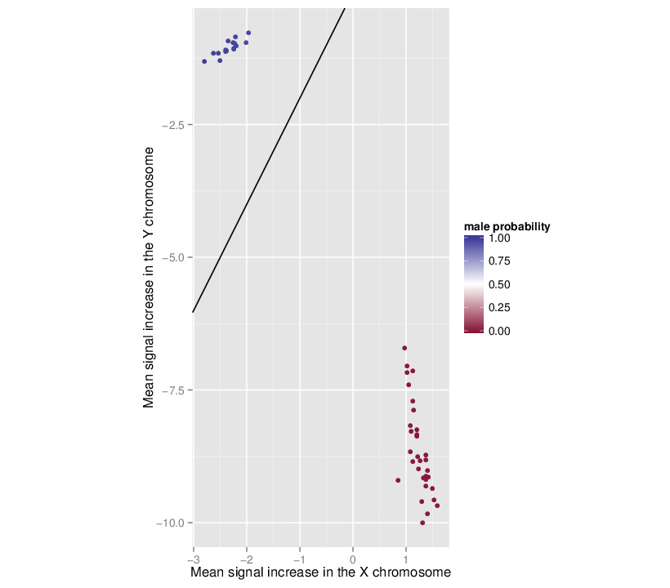
Data Quality-3
Gender Prediction

Slide 11
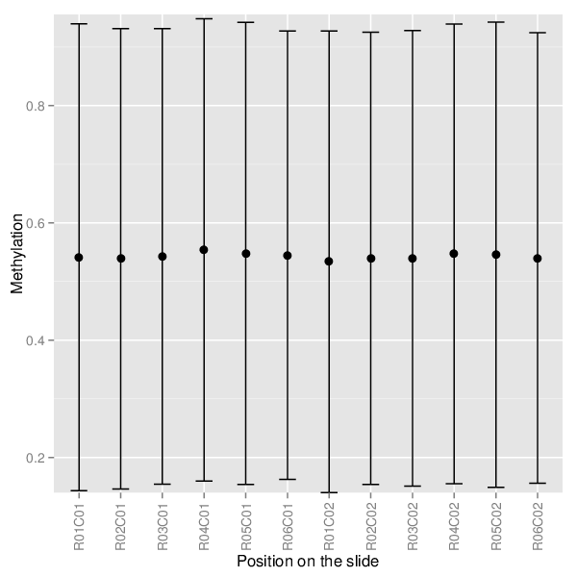
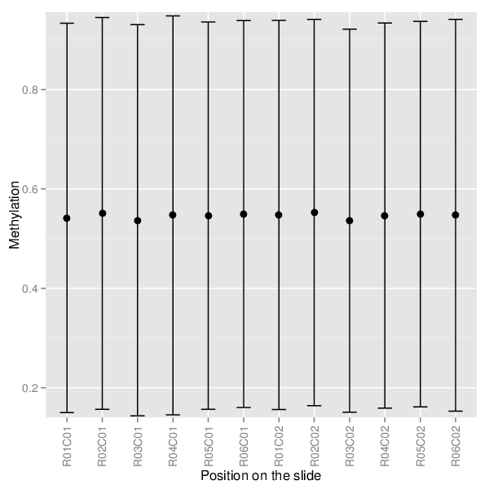
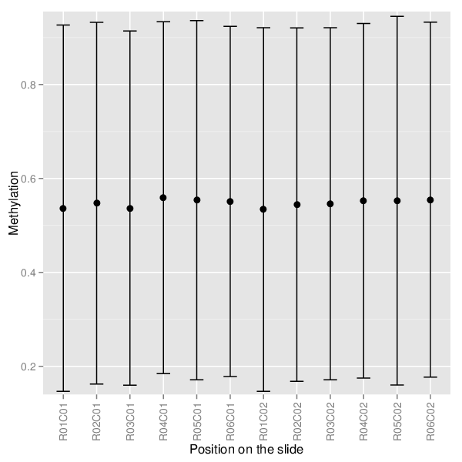
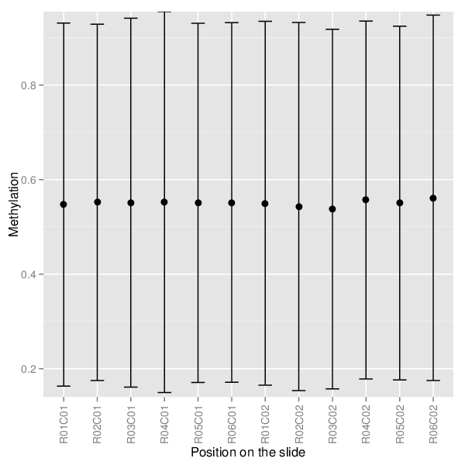
Data Quality-4
Sample Mean Methylations

Slide 12
Methylation 450K Array
Analysis Pipeline
CD4 vs.CD8 Analysis
CD4 Total Analysis
CD4 subtype Analysis
CD8 Total Analysis
CD8 subtype Analysis
CD4&CD8 Total Analysis
SLE CD4 MDS plot
Data Quality

Slide 13
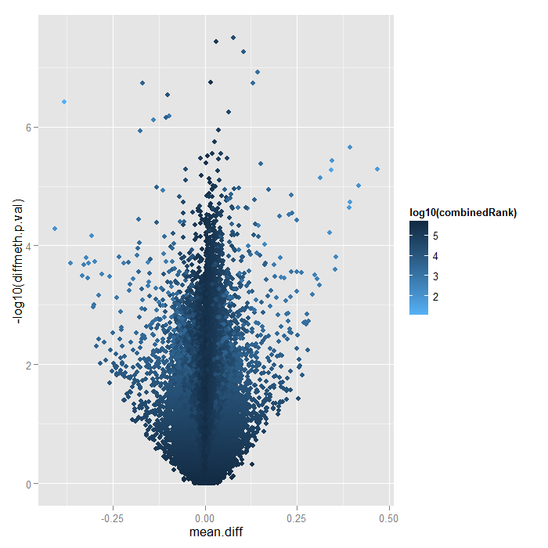
CD4&CD8 (n=24) vs. Control(n=24)

Slide 14
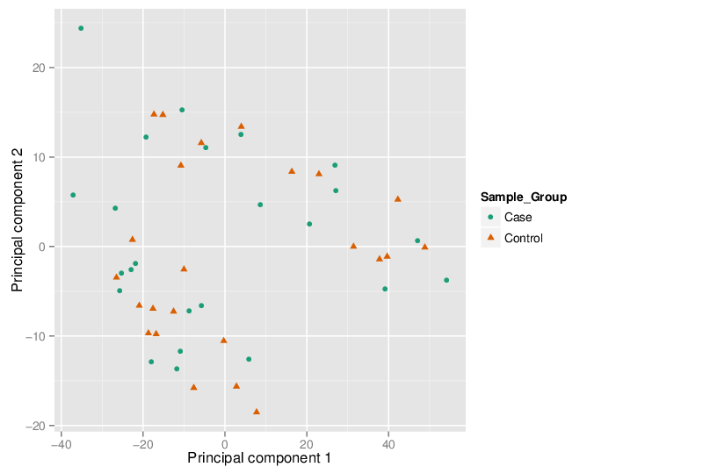
CD4&CD8 vs. Control PCA

Slide 15
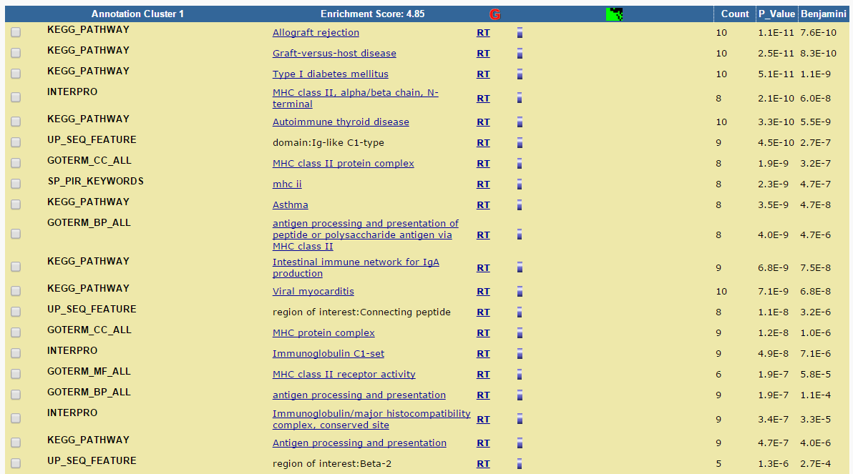
CD4&CD8 vs. Control- GO & KEGG Analysis

Slide 16
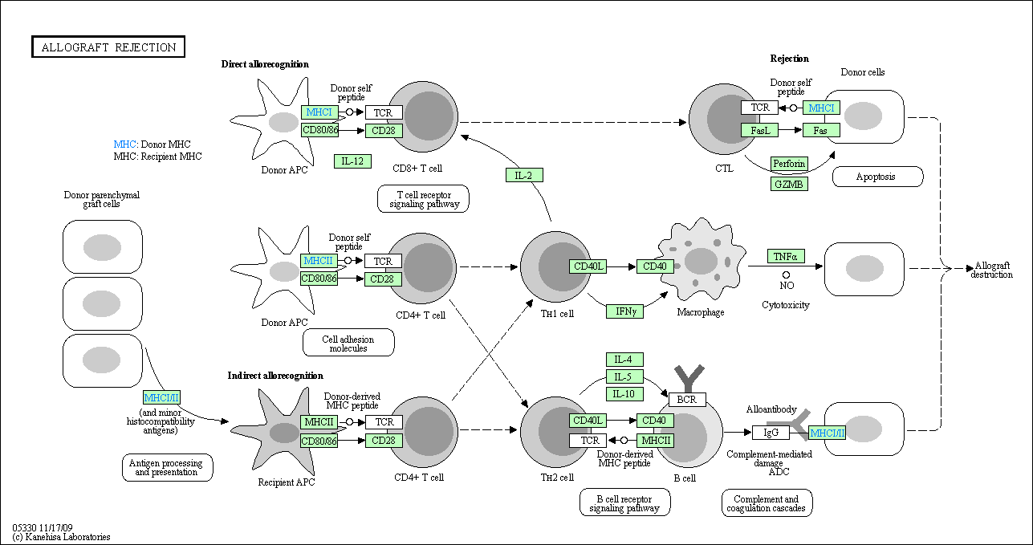
CD4&CD8 vs. Control- GO & KEGG Analysis

Slide 17
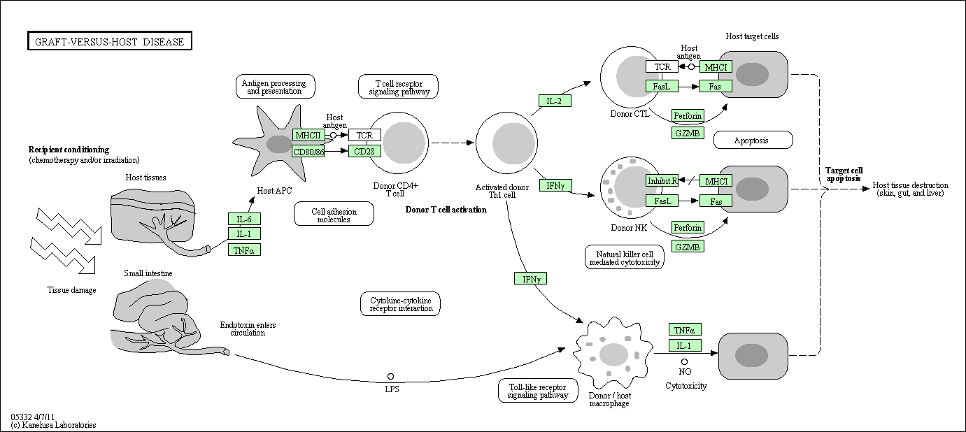
CD4&CD8 vs. Control- GO & KEGG Analysis

Slide 18
Methylation 450K Array
Analysis Pipeline
CD4 vs.CD8 Analysis
CD4 Total Analysis
CD4 subtype Analysis
CD8 Total Analysis
CD8 subtype Analysis
CD4&CD8 Total Analysis
SLE CD4 MDS plot
Data Quality

Slide 19
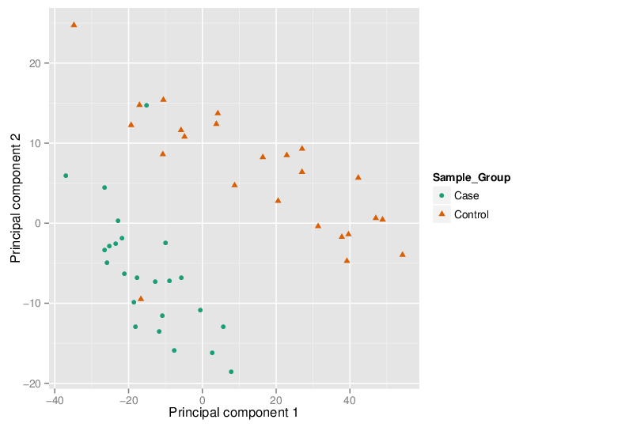
CD4 vs. CD8
Case:CD4 , Control:CD8

Slide 20
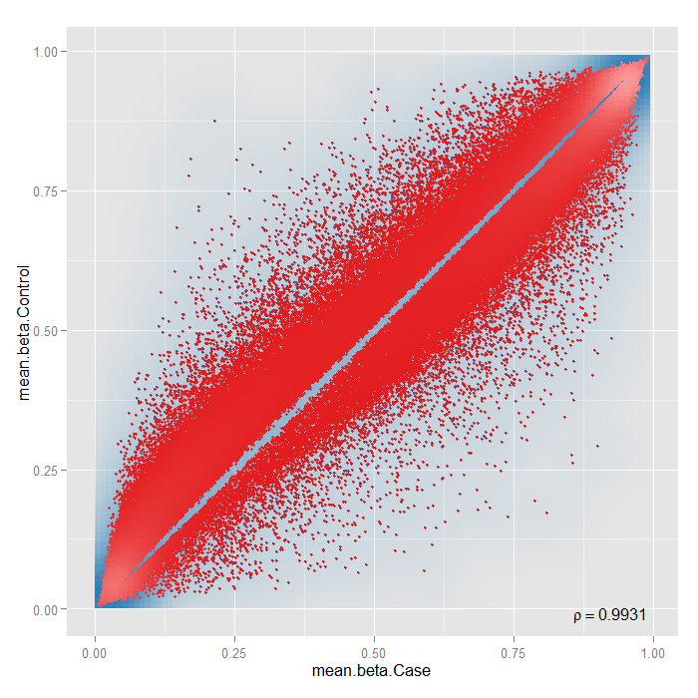
CD4 vs. CD8

Slide 21
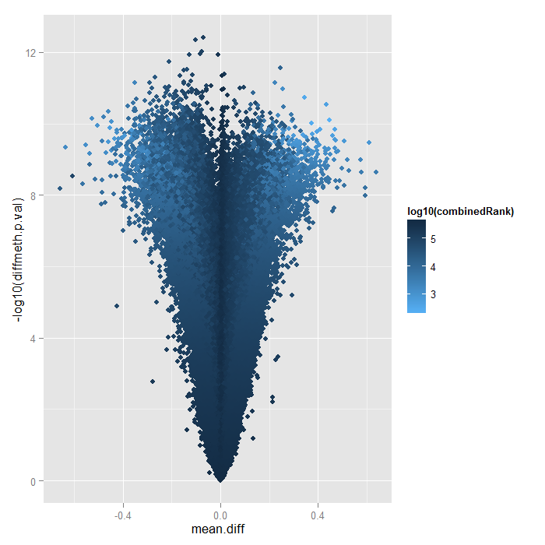
CD4 vs. CD8

Slide 22
Methylation 450K Array
Analysis Pipeline
CD4 vs.CD8 Analysis
CD4 Total Analysis
CD4 subtype Analysis
CD8 Total Analysis
CD8 subtype Analysis
CD4&CD8 Total Analysis
SLE CD4 MDS plot
Data Quality

Slide 23
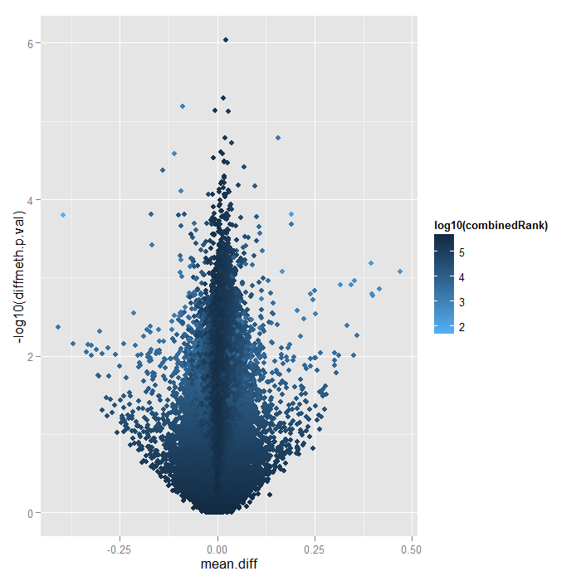
CD4(n=12) vs. Control(n=12)

Slide 24
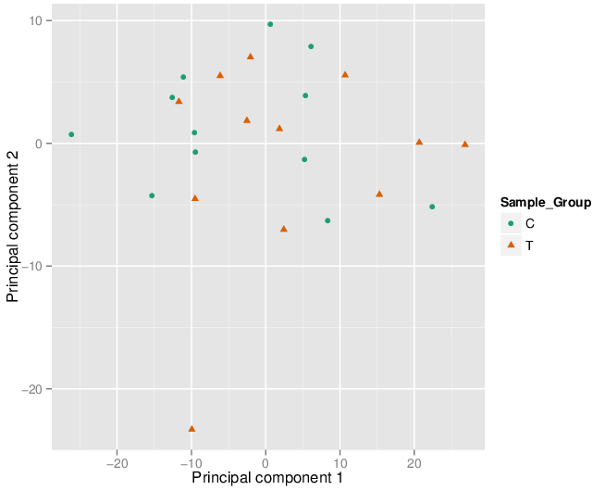
CD4 vs. Control- PCA

Slide 25
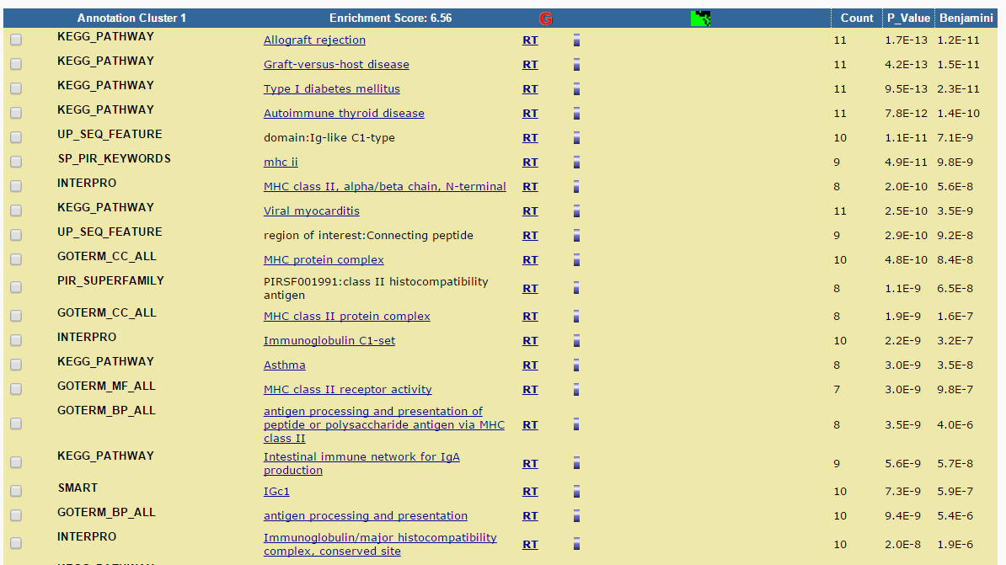
CD4 vs. Control GO Analysis

Slide 26
CD4 vs. Control GO & KEGG Analysis
Allograft Rejection

Slide 27
CD4 vs. Control GO & KEGG Analysis
Graft- Versus – Host Disease

Slide 28
Methylation 450K Array
Analysis Pipeline
CD4 vs.CD8 Analysis
CD4 Total Analysis
CD4 subtype Analysis
CD8 Total Analysis
CD8 subtype Analysis
CD4&CD8 Total Analysis
SLE CD4 MDS plot
Data Quality

Slide 29
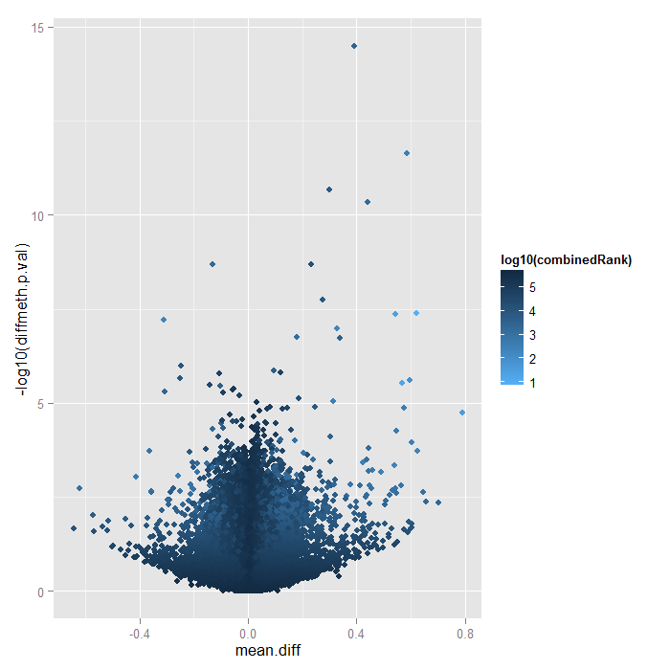
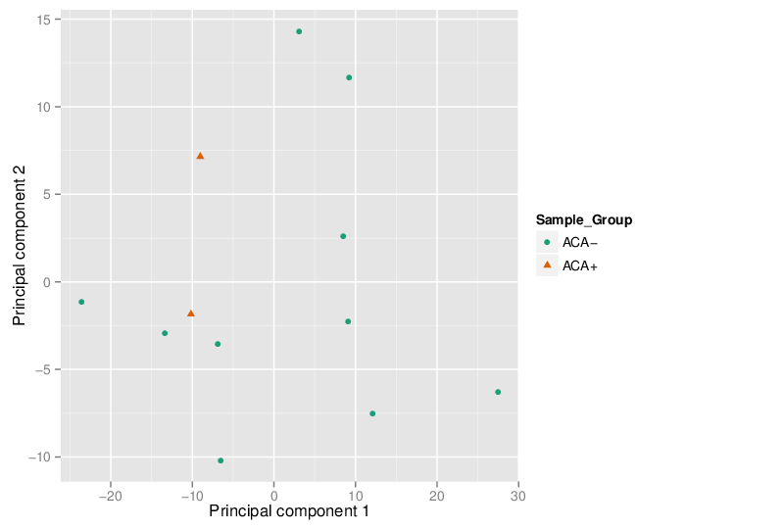
CD4 Subset Analysis- ACA-(n=10) vs. ACA+(n=2)
PCA Plot

Slide 30
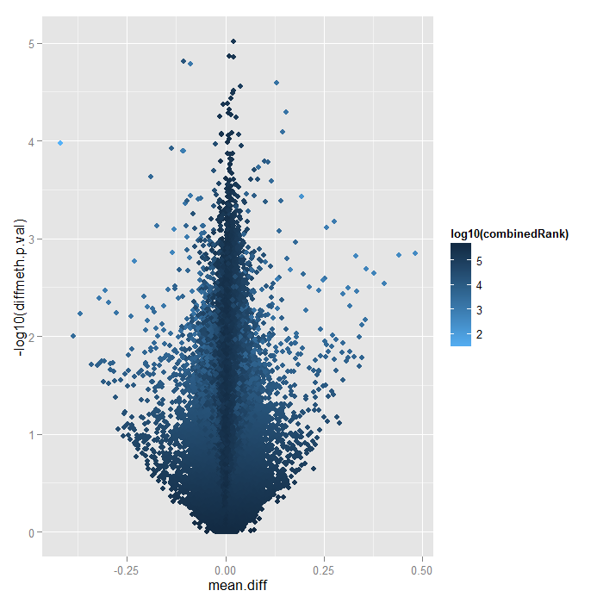
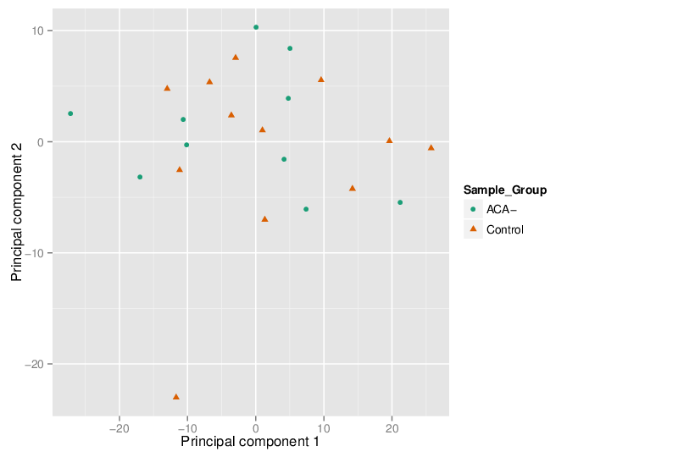
CD4 Subset Analysis- ACA- (n=10) vs. Control(n=12)
PCA Plot

Slide 31
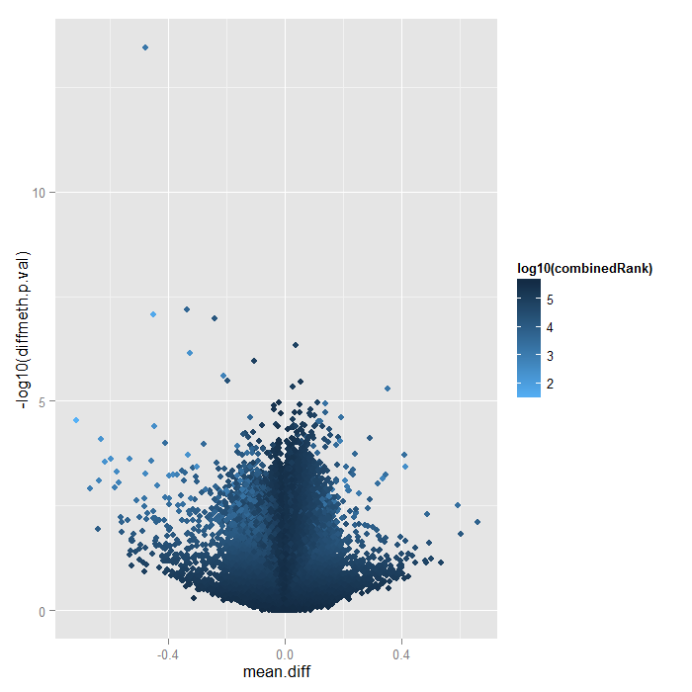
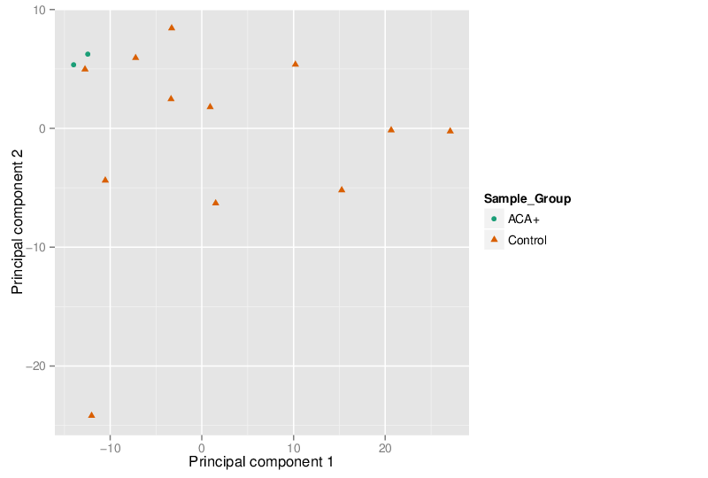
CD4 Subset Analysis- ACA+(n=2) vs. Control (n=12)

Slide 32
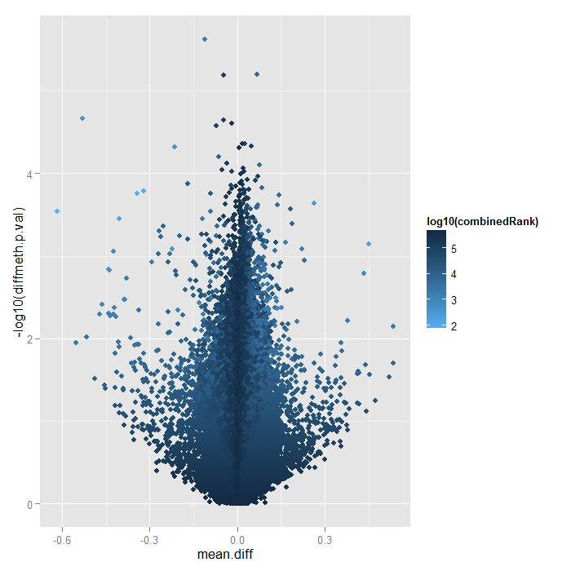
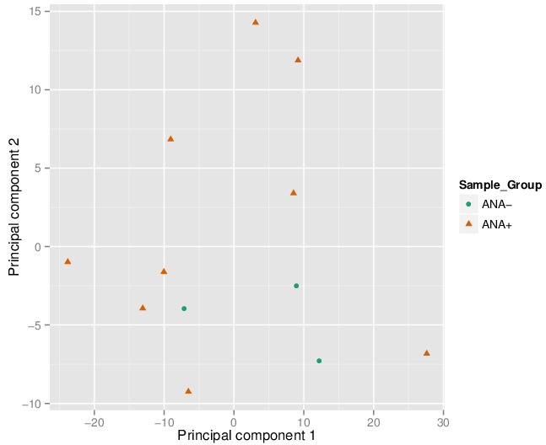
CD4 Subset Analysis-ANA+(n=9) vs. ANA- (n=3)
PCA Plot

Slide 33
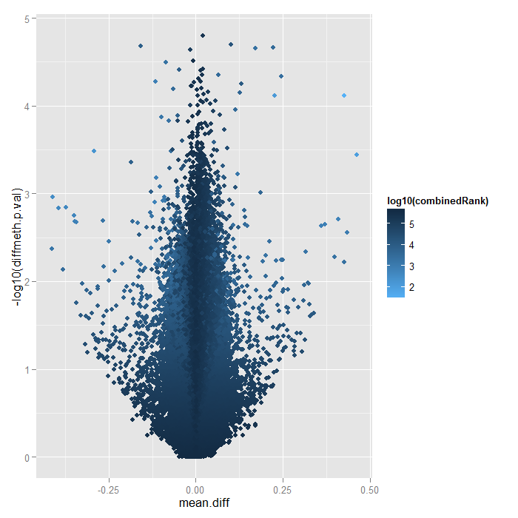
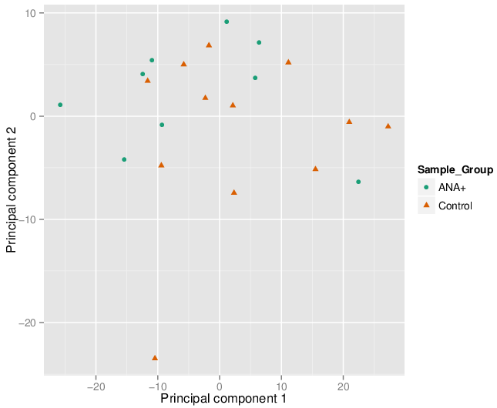
CD4 Subset Analysis-ANA+(n=9) vs. Control (n=12)
PCA Plot

Slide 34
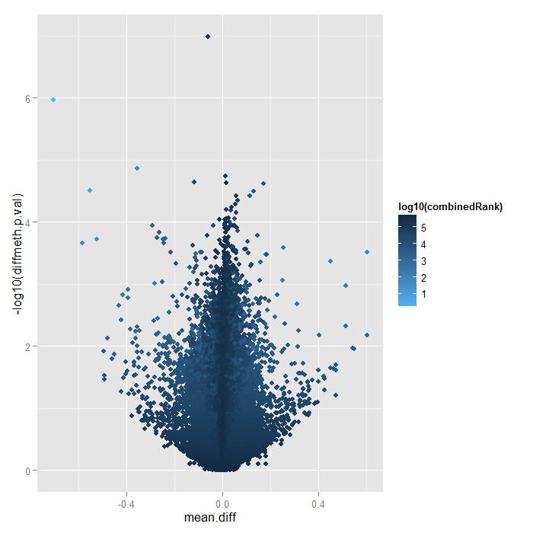
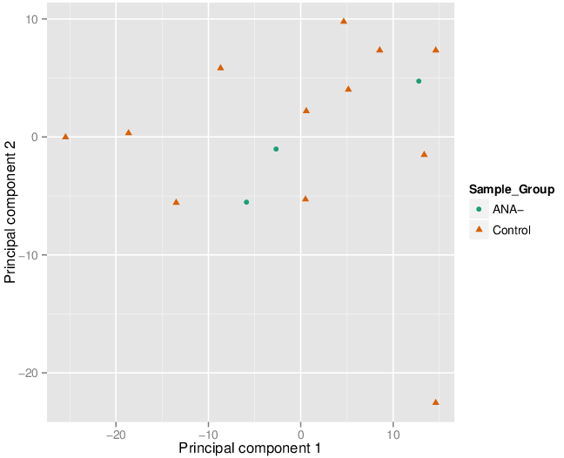
CD4 Subset Analysis-ANA-(n=3) vs. Control (n=12)
PCA Plot

Slide 35
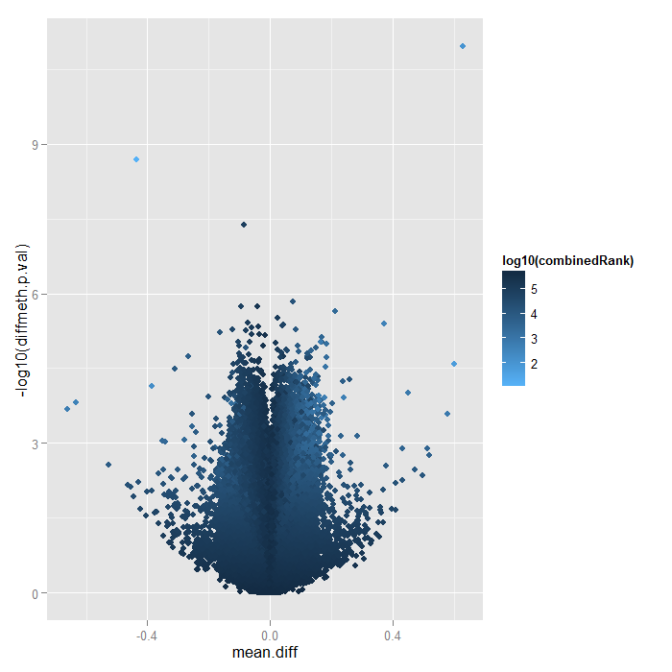
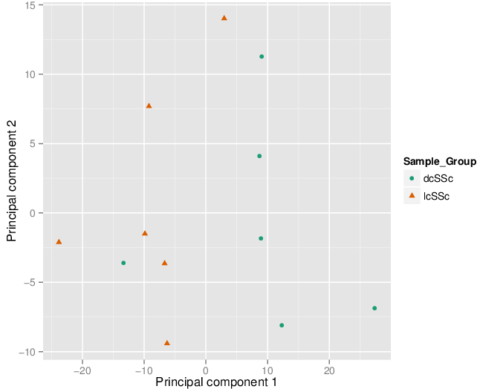
CD4 Subset Analysis-dcSSc(n=6) vs. lcSSc(n=6)
PCA Plot

Slide 36
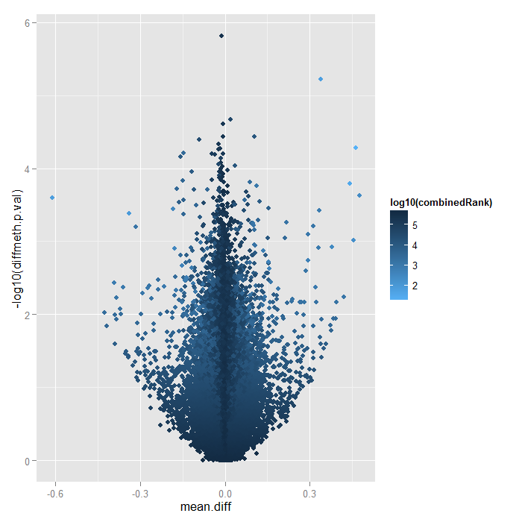
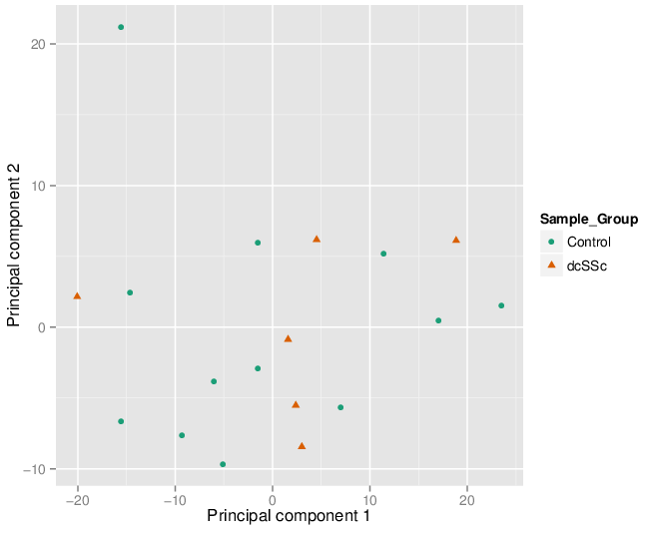
CD4 Subset Analysis-dcSSc(n=6) vs. control(n=12)
PCA Plot

Slide 37
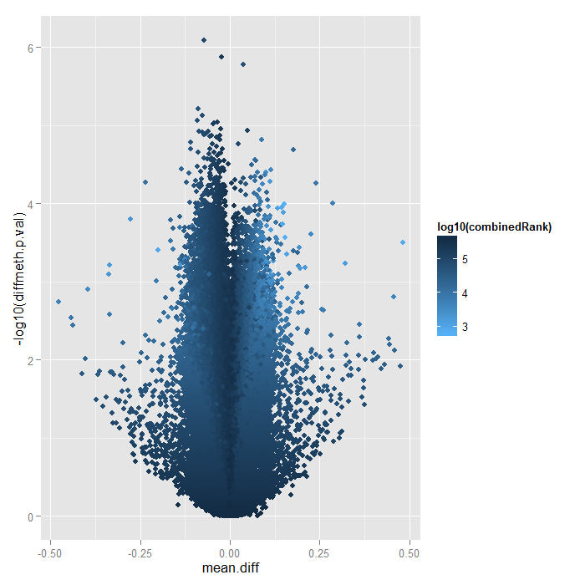
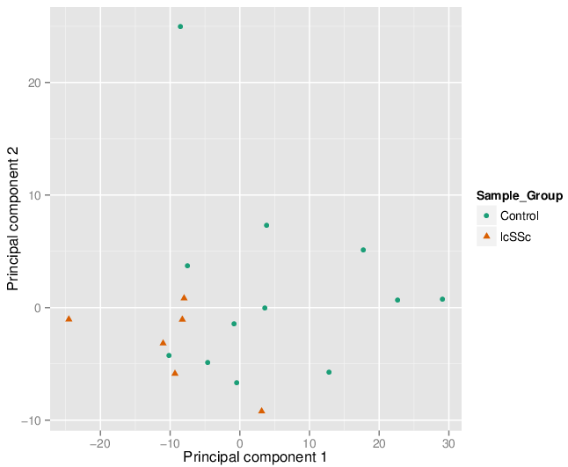
CD4 Subset Analysis-lcSSc(n=6) vs. control(n=12)
PCA Plot

Slide 38
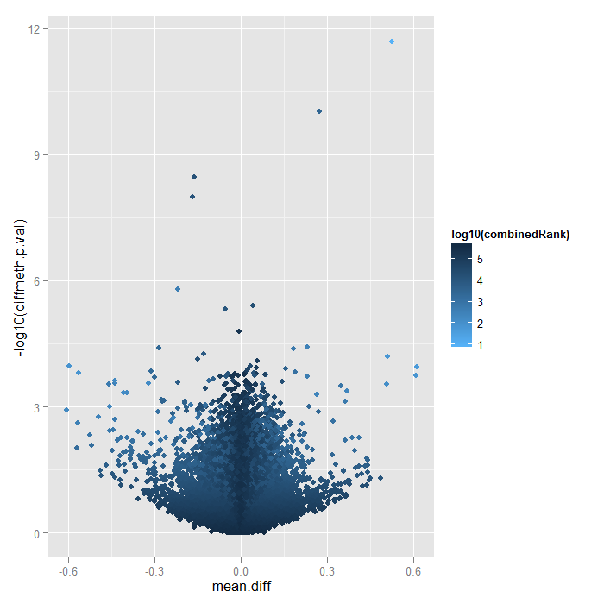
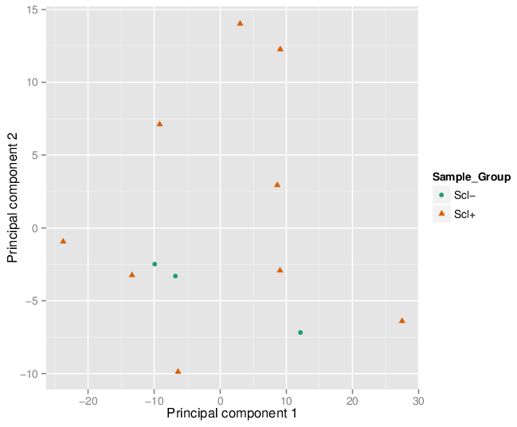
CD4 Subset Analysis-Scl+(n=9) vs. Scl-(n=3)
PCA Plot

Slide 39
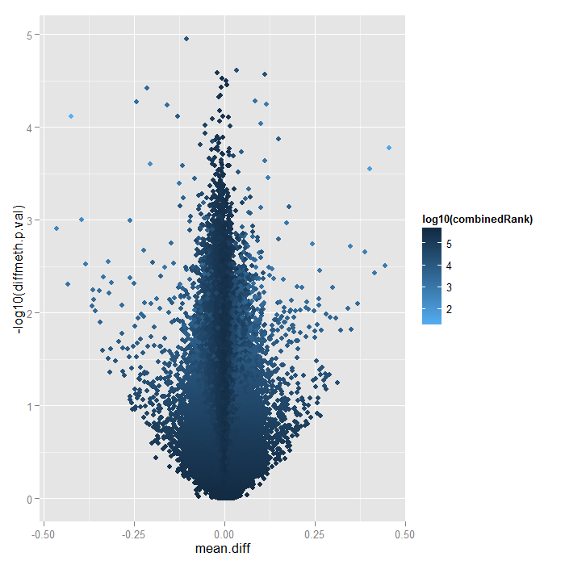
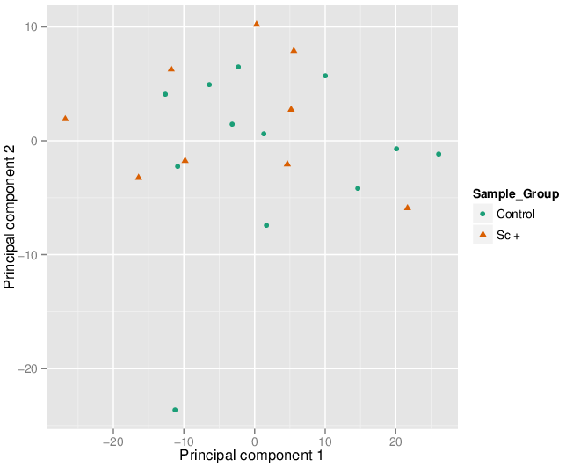
CD4 Subset Analysis-Scl+(n=9) vs. control(n=12)
PCA Plot

Slide 40
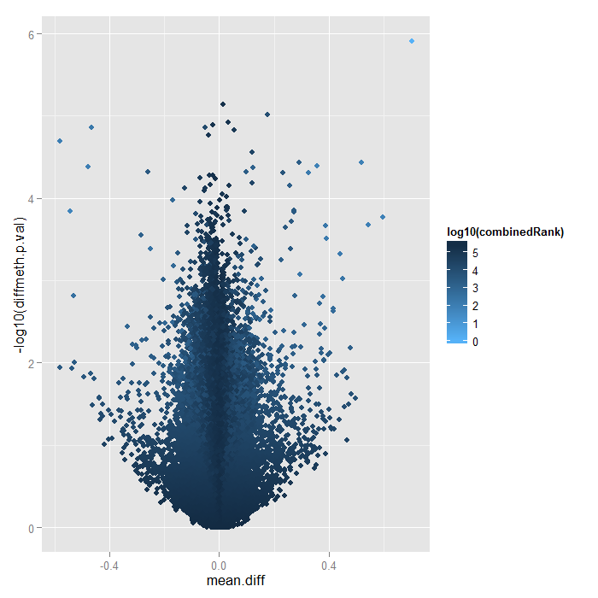
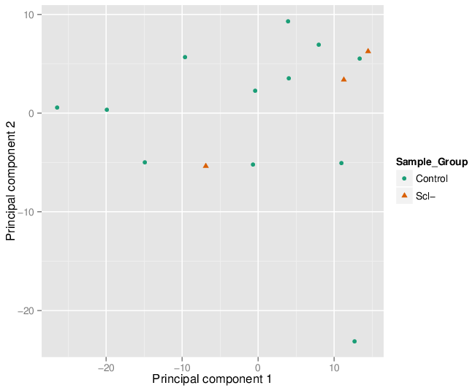
CD4 Subset Analysis-Scl-(n=3) vs. control(n=12)
PCA Plot

Slide 41
Methylation 450K Array
Analysis Pipeline
CD4 vs.CD8 Analysis
CD4 Total Analysis
CD4 subtype Analysis
CD8 Total Analysis
CD8 subtype Analysis
CD4&CD8 Total Analysis
SLE CD4 MDS plot
Data Quality

Slide 42
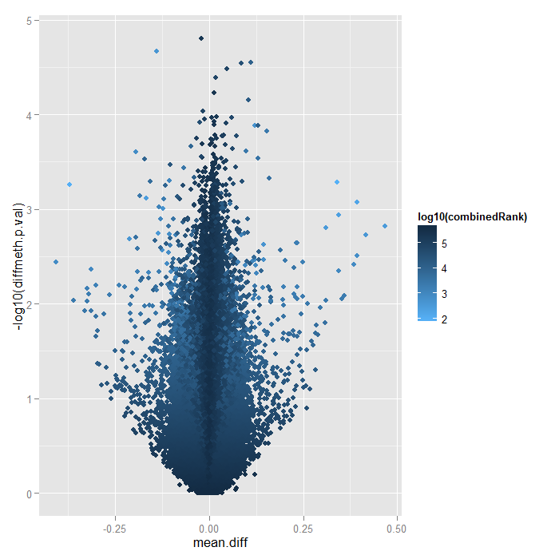
CD8 (n=12)vs. Control(n=12)

Slide 43
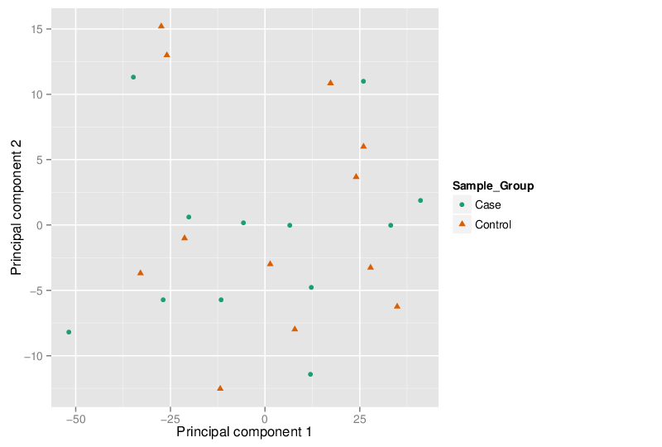
CD8 vs. Control PCA

Slide 44
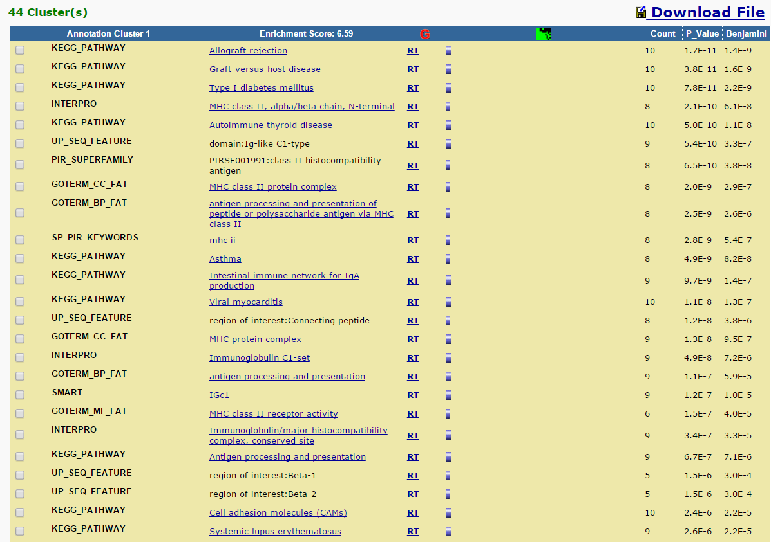
CD8 vs. Control GO Analysis

Slide 45
Methylation 450K Array
Analysis Pipeline
CD4 vs.CD8 Analysis
CD4 Total Analysis
CD4 subtype Analysis
CD8 Total Analysis
CD8 subtype Analysis
CD4&CD8 Total Analysis
SLE CD4 MDS plot
Data Quality

Slide 46
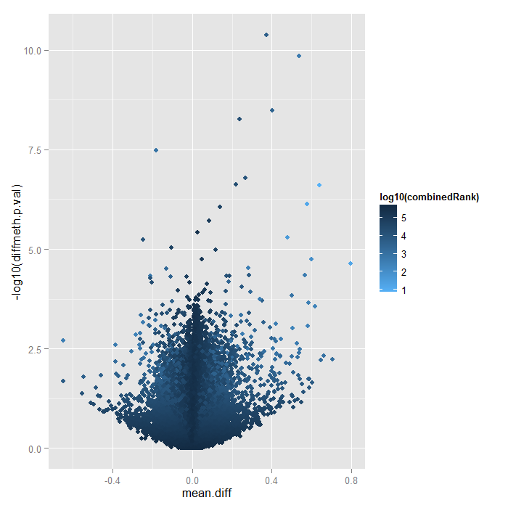
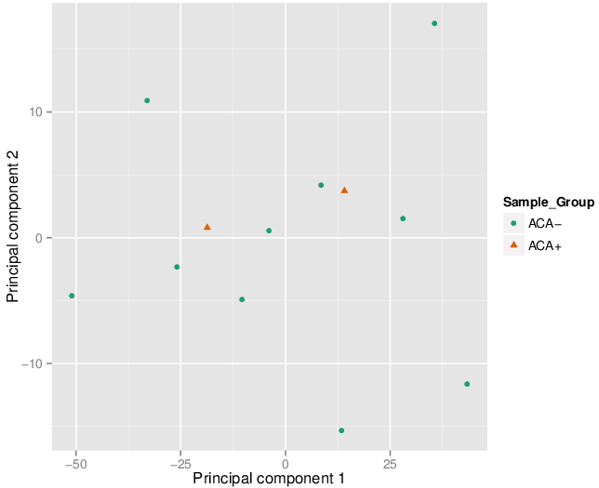
CD8 Subset Analysis- ACA+(n=2) vs. ACA-(n=10)
PCA Plot

Slide 47


CD8 Subset Analysis- ACA+(n=2) vs. control(n=12)
PCA Plot

Slide 48


CD8 Subset Analysis- ACA-(n=10) vs. control(n=12)
PCA Plot

Slide 49


CD8 Subset Analysis- ANA+(n=9) vs. ANA-(n=3)
PCA Plot

Slide 50


CD8 Subset Analysis- ANA+(n=9) vs. control(n=12)
PCA Plot

Slide 51


CD8 Subset Analysis- ANA-(n=3) vs. control(n=12)
PCA Plot

Slide 52


CD8 Subset Analysis- dcSSc(n=6) vs. lcSSc(n=6)
PCA Plot

Slide 53


CD8 Subset Analysis- dcSSc(n=6) vs. control(n=12)
PCA Plot

Slide 54


CD8 Subset Analysis- lcSSc(n=6) vs. control(n=12)
PCA Plot

Slide 55


CD8 Subset Analysis- Scl+(n=9) vs. Scl- (n=3)
PCA Plot

Slide 56


CD8 Subset Analysis- Scl+(n=9) vs. control (n=12)
PCA Plot

Slide 57


CD8 Subset Analysis- Scl-(n=3) vs. Control (n=12)
PCA Plot

Slide 58
Methylation 450K Array
Analysis Pipeline
CD4 vs.CD8 Analysis
CD4 Total Analysis
CD4 subtype Analysis
CD8 Total Analysis
CD8 subtype Analysis
CD4&CD8 Total Analysis
SLE CD4 MDS plot
Data Quality

Slide 59

SLE CD4 MDS Plot- SLE(n=76) vs.control(n=71)

